Slide 1
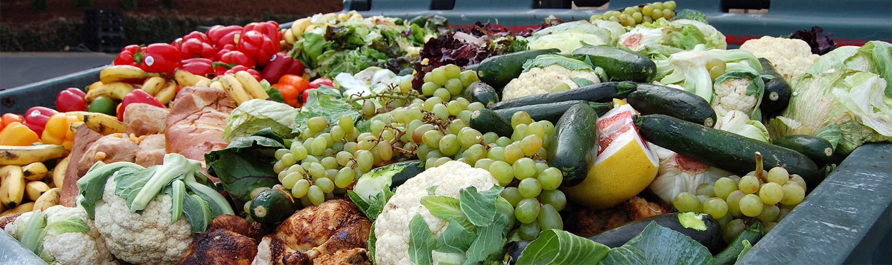

FOOD WASTE
- Anne de JERPHANION & Claire MAGNIEN -
LYON | MARCH 5, 2018

Slide 2

PLAN
PLAN
I) Definitions
II) Current situation around the word
III)The causes of food waste – different players
Agricultural production
Post-harvest handling and storage
Processing
Distribution
Consumption
IV) Solutions
V) Conclusion

Slide 3
I - Definitions
I) DEFINITIONS
Food Waste
“Food thrown away that was earlier good enough for people to eat.” (FAO, 2010)
= “any removal of food from the food supply chain” (EU Fusions)
Food wastage
“Any food lost by deterioration or waste. The term “wastage” encompasses both food loss and food waste.”(Food and Agriculture Organisation FAO, 2010)
Food Loss
“A decrease in quality (e.g. nutritional value) or quantity (dry matter) of food that was originally intended for human consumption.” (FAO, 2010)

Slide 4
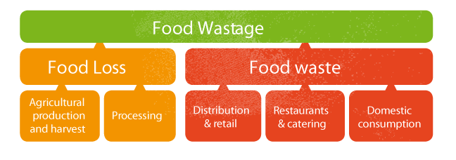

I) DEFINITIONS
Difference between Food Loss and Food Waste
*Harvest = the gathering of crops
*Catering = providing and serving meals, as for a party or wedding
Food Loss takes place at the beginning of the food supply chain.
≠
Food Waste occurs at the end of the food supply chain.
(FAO, 2017)

Slide 5

According to the United Nations Food and Agricultural Organisation, what percentage of food is wasted each year?
25 %
33 %
50 %
33 %
One-third of food produced for human consumption is lost or wasted globally, which amounts to about 1.3 billion tons per year.

Slide 6
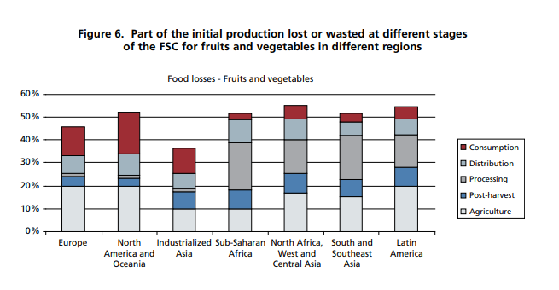
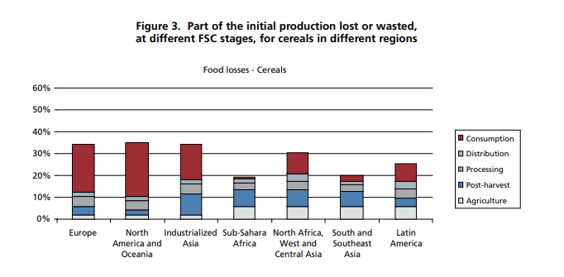
II) CURRENT SITUATION AROUND THE WORLD
Figure 1 (The Global Food Losses and Food Waste Report, 2011, FAO.org)

Slide 7




II) CURRENT SITUATION AROUND THE WORLD
Global quantitative food losses and waste for each commodity group per year:
30% cereals
35% fish and seafood
45% fruits and vegetables
45% roots and tubers
-> Industrialized and developing countries dissipate roughly the same quantities of food, respectively 670 and 630 million tonnes.

Slide 8
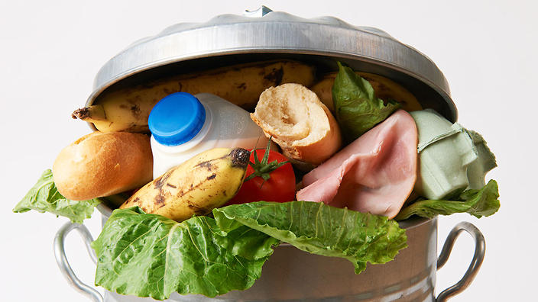
CURRENT SITUATION AROUND THE WORLD 2/5
Globally we produce enough food to feed everyone.
¼ of what we waste is enough to end world hunger
Food waste amounts to : US$ 680 billion in industrialized countries US$ 310 billion in developing countries.
Developing countries: 40% of losses -> at post-harvest and processing levels Industrialized countries : more than 40% of losses ->at retail and consumer levels.
(sbs.com.au, Reduce Waste)

Slide 9
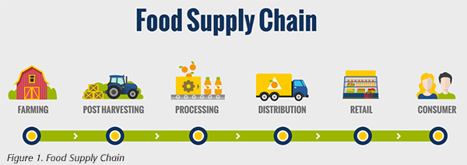
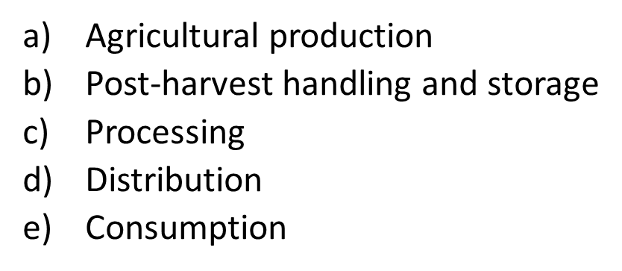
III) THE CAUSES OF FOOD WASTE
(Food Safety Magazine, 2018)

Slide 10

III) THE CAUSES OF FOOD WASTE
a) Agricultural production
Developed countries INDUSTRIALIZED AGRICULTURE | Developing countries THE MOST AFFECTED
Economic factors : regulation and standards for quality and appearance → CULLING | Lack of infrastructures and financial limitations
 | Lack of knowledge and technical limitations in harvesting
 | Natural forces : severe weather (temperature, precipitation)
Pest infestation, diseases, weeds, climatic variations

Slide 11
b) Post harvest handling and storage
III) THE CAUSES OF FOOD WASTE
Developed countries | Developing countries
Harvest sorting because of regulation and standards for quality and appearance. | Financial difficulties, lack of technology, insufficient knowledge and management.
 | Lack or poor cooling facilities and hot climates -> break in the cold chain.
 | Poor storage facilities : sun exposure, parasites and insects.
Pest infestation
Amounts of post harvest loss involved are relatively unknown and difficult to estimate.

Slide 12
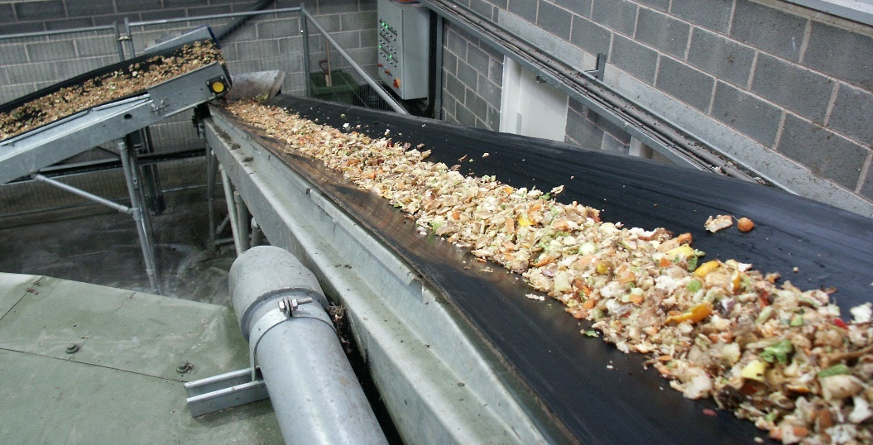
III) THE CAUSES OF FOOD WASTE
c) Processing
Food standards for processing capability -> sorting
Errors during food processing.
Losses during peeling, slicing, boiling and sorting. But also during fish canning, smoking and salting.
Human error
(Food waste, Wrap.org.uk)
Developing countries: Lack of processing facilities, lack of technology, poor infrastructure.

Slide 13
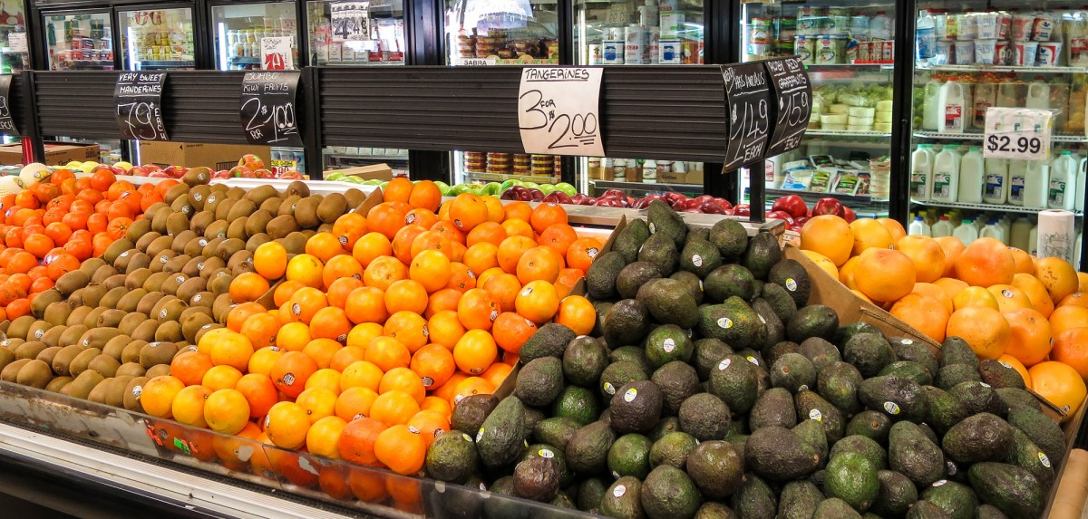
d) Distribution
III) THE CAUSES OF FOOD WASTE
Over-ordering
Difficulty in planning the customers’ desires
Break in the cold chain
Products that is approaching the best before date
Products damaged by the customers or during the shelving

Slide 14
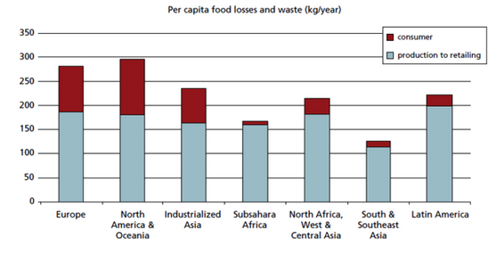
e) Consumption
III) THE CAUSES OF FOOD WASTE
Figure 2 : Food loss and food waste around the word
(The Global Food and Waste Report 2011, FAO)

Slide 15
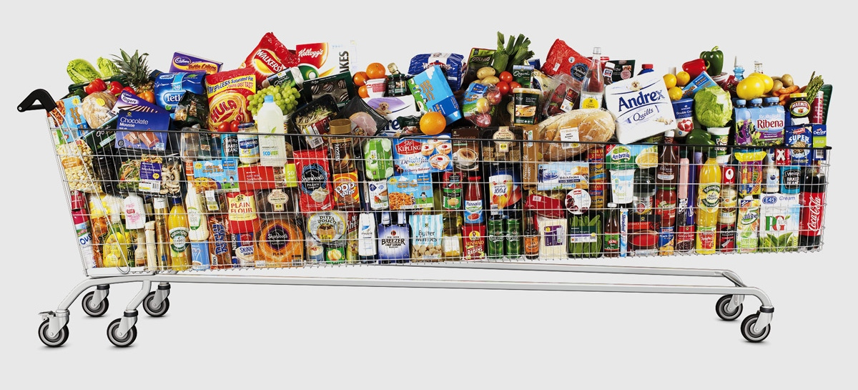
e) Consumption
III) THE CAUSES OF FOOD WASTE
Top three reasons
Buying and stocking too much food
Over preparing or not cooking it properly
Leaving food on dishes after meals or not willing to consume leftovers
(All event, 2017)

Slide 16

IV) SOLUTIONS
Agricultural production to processing:
Developing countries :
Premature harvesting : organizing groups of small farmers. bring knowledge.
Investment in infrastructure, technical and transportation. Sensitize about the preservation of the cold chain.
Developed countries:
When production exceeds demand : cooperation between farmers.
Using appropriate packaging.
Value the whole commodity.
(Packaginginfair.com, Cold Chain)

Slide 17

IV) SOLUTIONS
Distribution:
Supermarkets : redistribution to charities.
Take measures: For example, a French law (February 2016) forbids food waste by supermarkets.
Restaurant : Doggy bag: it is a container for leftover food to be carried home from a meal eaten at a restaurant.
(Atabula.com, Doggy Bag)

Slide 18

IV) SOLUTIONS
Consumers : Homo Economicus vs. Homo Moralis
Before shopping
Plan meals before shopping
Check your cabinets and your fridge and try to use what you already have
At the grocery
Buy only what you need, in realistic quantities
Buy ugly fruit and vegetable (30% cheaper) = SubOptimal Food (SOF)
At home
Use all edible parts of food, like the radish tops or cucumber peels
Freeze anything you can’t eat before it spoils
Find ways to use items past their prime
Store your ingredients correctly for prolonged freshness
Clean out your pantry and donate any items you don’t use
“Best before [date]”
≠
“Use by [date]”

Slide 19



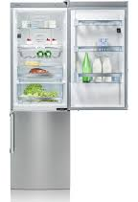


IV) SOLUTIONS
Tackling food waste around the world through technology :
Applications
TooGoodToGo
(Europe and the US)
Winnow
(Europe, Asia, Australia)
FoodCloud
(Ireland and the UK)
The Bump Mark
A bio reactive food expiry label
Bosch Smart Connect Fridge
A very cool smart fridge

Slide 20

Conclusion
V) CONCLUSION
Developing countries: Food waste occurs mainly at early stages of the food supply chain.
Developed countries: Food waste occurs mainly at the end of the food supply chain.
There are lots of solutions.
All actors of the food supply chain play a part in food waste. In developed countries, consumers must react and reduce wastage.
(Madaily.com, Eliminate waste.)

Slide 21
Bibliography
BIBLIOGRAPHY
Food and Agriculture organisation of the United Nations. Food loss and food waste. [Online]. Available from: http://www.fao.org/food-loss-and-food-waste/en/?em_pos=large&emc=edit_nn_20161125&nl=morning-briefing [Accessed on 18 February 2018].
United Nations. Zero hunger challenge. [Online]. Available from: http://www.un.org/en/zerohunger/challenge.shtml [Accessed on 18 February 2018].
Galanakis, Charis M. Food Waste Recovery : Processing Technologies and Industrial Techniques [Online] Elsevier Science, 2015, 412 pages, Available from: http://unr-ra.scholarvox.com/ [Accessed on 20 February 2018]. ISBN: 978-0-12-800351-0.
European Comission. Food Waste. [Online]. Available from: https://ec.europa.eu/food/safety/food_waste_en [Accessed on 19 February 2018].
World Wide Life Foundation (WWF). Food Waste. [Online]. Available from: https://www.worldwildlife.org/initiatives/food-waste [Accessed on 22 February 2018]

Slide 22

Thank you for your attention. Do you have any question ?
QUESTIONS

